Slide 1
Pizza Store Analysis
Power Bi Dashboard

Slide 2
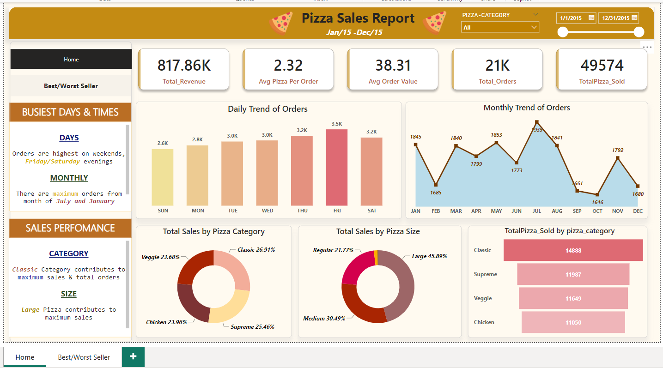

Slide 3
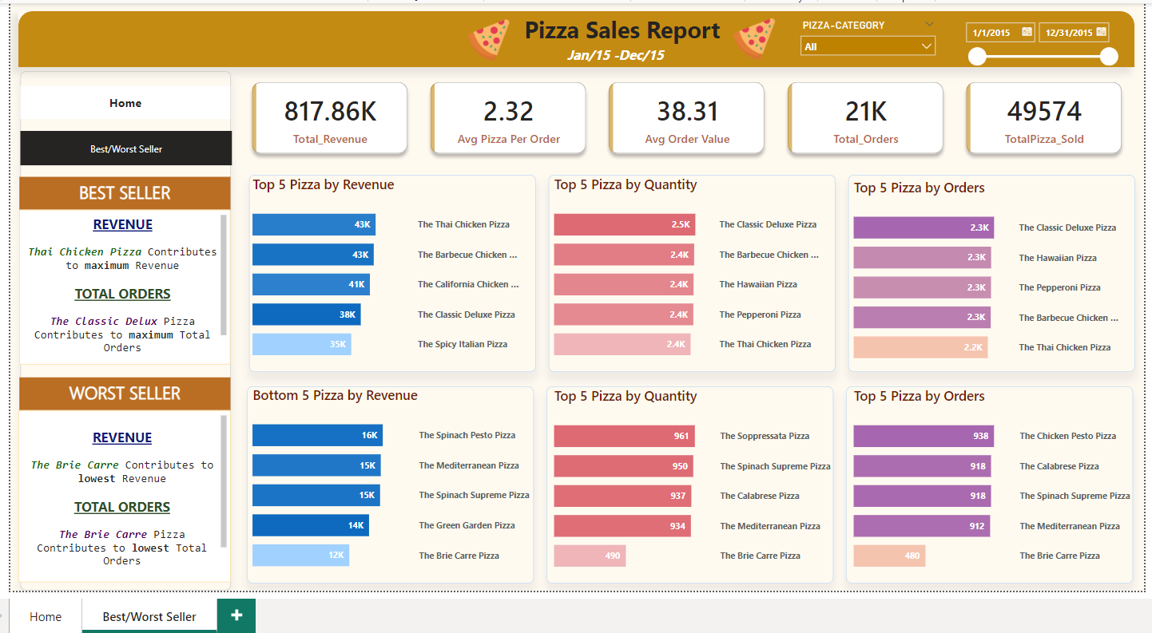

Slide 4
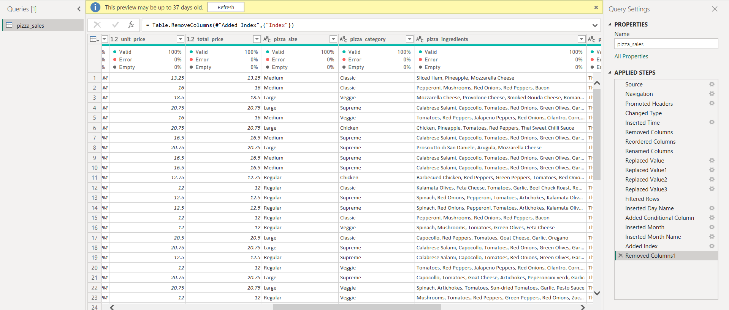
Power Query

Slide 5
THANK YOU

